Slide 1
Programming Fundamentals
Lecture 3

Slide 2
Objectives
To know about basic data types and memory concepts
To know about arithmetic operators
To know about equality and assignment operators
To review the relational operators
To revise the use of the increment and decrement operators
To know about compound operators
To know about manipulators

Slide 3
Memory Concepts
While doing programming in any programming language, you need to use various variables to store various information
Variables are nothing but reserved memory locations to store values
This means that when you create a variable you reserve some space in memory

Slide 4



Memory Concepts
int number1;
int number2;
int sum;
number1 = 45;
number1 = 72;
sum = number1 + number2;
45
72
117

Slide 5
Data Types
When you declare a variable in C++, it reserve some memory space
How much memory a variable will take??
It depends on the type of variable, often called as data type
Some built-in data types are given in next slide

Slide 6
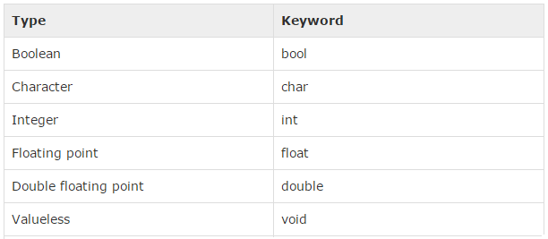
Data Types
Some basic data types are given below
Several of the basic types can be modified using signed, un-signed, long and short modifiers

Slide 7
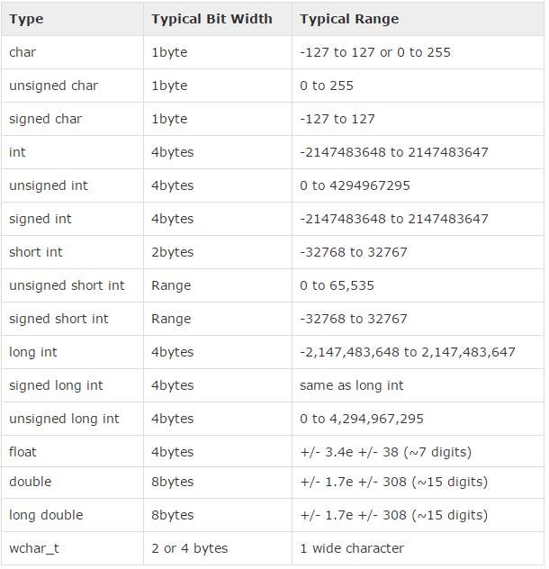

Slide 8
Data Types
The sizes of variables might be different from those shown in the last table, depending on the compiler and the computer you are using
To produce the correct size of any data type within your compiler you can use sizeof() operator

Slide 9
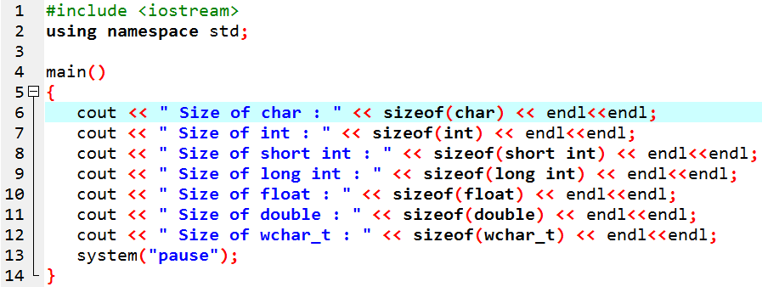
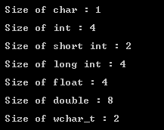
Data Types

Slide 10
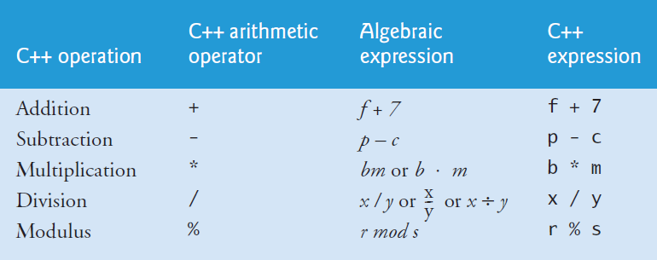
Arithmetic Operations
You can perform following operations in C++

Slide 11
Arithmetic Operations
Addition, subtraction and multiplication can be used on integers, float, double etc
The integer division (/) can only be used with integers
For example 26/4 will produce the answer 6
Similarly 61/6 will produce the answer 10
The modulus operator (%) can be used with integers only and return the remained of the division
For example 26%4 will produce the answer 2
Similarly 61%6 will produce the answer 1
The use of “/” and “%” operator with non-integer variables will produce an error if automatic type conversion is not available in your compiler

Slide 12
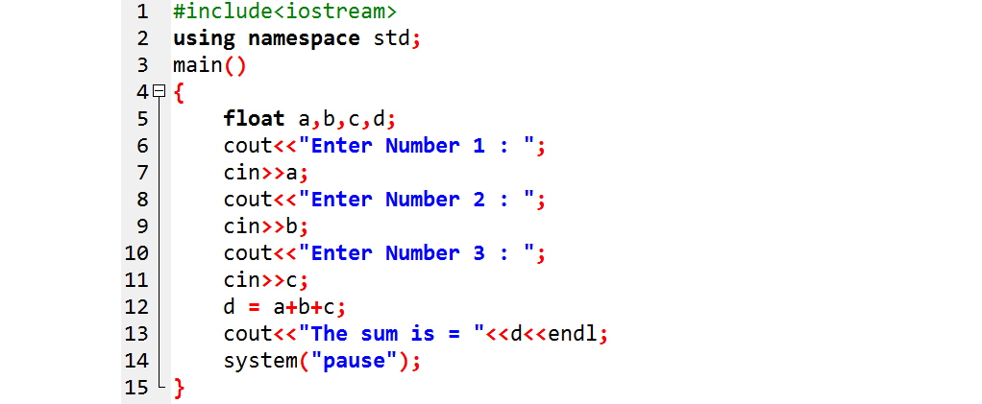
Simple Tasks
Write a program in C++ to add three numbers (that can be integer or float) entered by the user and display the numbers and their sum on the screen

Slide 13
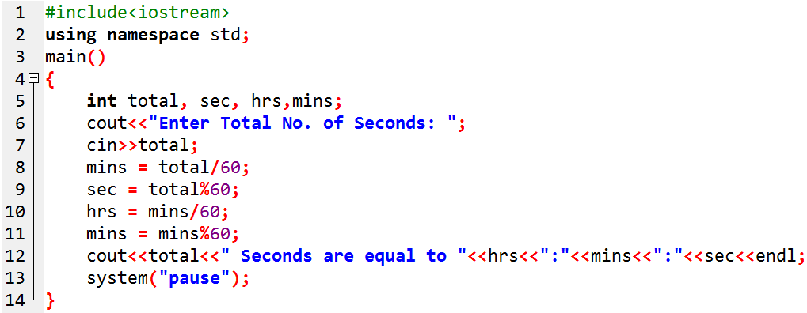
Simple Tasks
3. Write a program to convert seconds entered by user to hours, minutes and seconds. The display should be in standard format like
Hours : Minutes : Seconds

Slide 14
Equality & Assignment Operator
== is an equality operator, which is used for comparison of two variables
A==B;
The above statement will compare the values of A and B
= is an assignment operator, which assigns a value to a variable
A = B;
The above statement means that the value of B is assigned to A

Slide 15
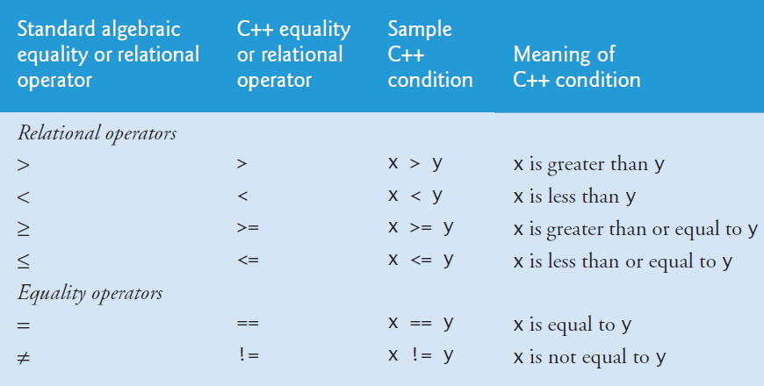
Relational Operations in C++
Relational operators and their C++ syntax

Slide 16
Common Errors
Reversing the order of pair of symbols in the operators !=, >= or <= (writing them as =!, => and =<)
It will normally lead towards a syntax error
Confusing the equality (==) operator with assignment (=) operator
It will result as a logical error

Slide 17
Increment and Decrement Operators
Increment operator (++) increases the value of a variable by 1
There are two types of increment operator
Pre-increment
Post-increment
Decrement operator (--) decreases the value of a variable by 1
There are two types of decrement operator
Pre-decrement
Post-decrement

Slide 18
Pre and Post Increment/Decrement
++a → Pre-increment
Increment a by 1, then use the new value of a in the expression in which a resides
a++ → Post-increment
Use the current value of a in the expression in which a resides then increment a by 1
--a → Pre-decrement
Decrement a by 1, then use the new value of a in the expression in which a resides
a-- → Post-decrement
Use the current value of a in the expression in which a resides then decrement a by 1

Slide 19
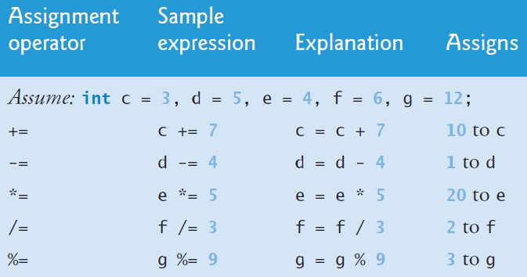
Compound Assignment Operators
Compound assignments can be used when you want to modify the value of a variable by performing an operation on the value currently stored in that variable. (For example: A = A + 1 )

